Slide 1
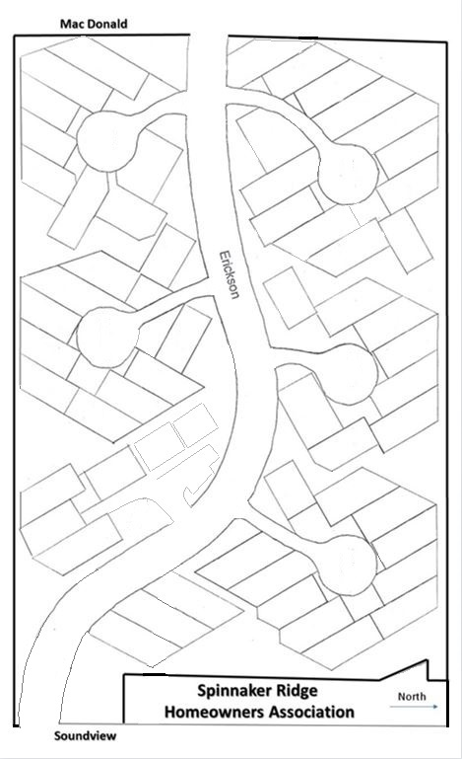
Mc Donald
6777 – Mechtild Suplik
(36)
6810 – Jeannie Farrington (35)
6830- Barry
& Margaret Clarno
(34)
6755 – Michael Scales & Barbara Bjerke (37)
6743 – John & Lynda Filson (38)
6850 – Robert (Chris) Wise (33)
6735 – Linda Kindred & Richard Seversen (39)
6860 – Will & Louise
Tieman (32)
6857 – Pete &
Debbie Steere
(23)
6870 – Tim & Lynda Byer (31)
6720 – Paul
Miller (40)
PORT
6880 – Roger & Connie Thompson (30)
6766 – Bill & Juli Wilkerson (44)
STARBOARD
6730 – Mimi Pearson (41)
6867 – Kay Derkacht (24)
6888 –Jerry & Judith Zylkowski
(29)
6744 – John & Gerianne Babbo (42)
6756 – Barb Carr &
Paul Schneider
(43)
6879 – Cathy Moss
(25)
6883 – David & Melanie Entzminger
(26)
6787 – Tom &
Sarah Brown (45)
6887 – Shelley McDaniel & Dan Joslin (27)
6889 – Margit
Gorton (28)
6757 – Laurel
Oldenburg (47)
6775 – Carol
Currie (46)
6820 – Tom &
Debra (Kay) Jenkins (22)
6846 – Ted & Jan Maresh (21)
6745 – Suzanne Leichman (48)
6864 – Ted & Donna Delude (20)
6734 – Joan Ryan
(49)
WEATHERGLASS
6780 – David & Susan
Winningham (54)
6876 – Rob Schachter & Vera Markovich (19)
6746– Pam Saasen
(50)
6770 – Jim & Carol Ferguson (53)
WINDLASS
6884– Jytte Doles
(18)
6760 – Steve & Kathy Bates (52)
6835 – Jim Stuart
(15)
6750 – Suzann & James Mooney (51)
Club
House
6885 – Bruce & Ramona Langness (17)
Pool
6855 – Jan Werner
(16)
6773 – Jim Skintauy &
Judy Riddle (55)
Parking
6733 – Dorothy Bailey
& Julie Martin (56)
6822– Bob & Debra Zollo (14)
6844 – Ray & Teresa Corpus (13)
SPINNAKER
6866 – Alan &
Debbie Hanan (12)
6766 – Claudia
Fischer (57)
6878 – Jim & Paulette Groves (11)
6788 – Rose Leggett
(58)
6801 – Tom & Carol Briggs (4)
6833 – Christopher Guest (5)
MAINSAIL
6886 – Phyllis Blackburn (10)
3177 – Ann Fessler
(3)
6845 – Dave Sanford & Mary Czerniak (6)
6887 – Donna Thomas (9)
3167 – Alan & Cynthia
Prichard (2)
6869 – Pat & Tammy Finn (7)
3155 – Kenneth (Dean) & Eileen Herzog (1)
6877– Mike &
Debbie Low (8)

